Slide 1

MOJ Property Transformation Programme
May 2026

Slide 2
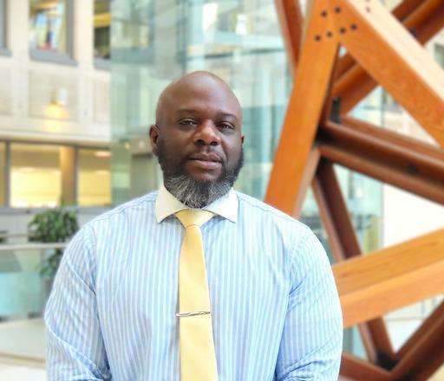
Property Transformation Programme
Mobilisation Professionals
Clayton Smith, Programme Director, Property Transformation Programme
Programme Director delivering the Property Transformation Programme (PTP). Leadership role delivering the programme to implement new FM contracts for HMPPS and a new performance management digital platform via the Workplace Management Service. The role has day-to-day leadership of all programme activities and significant responsibility for delivery two major procurement exercises, demobilising current contracts, mobilising new suppliers and delivering the required business change for successful transition and implementation.

Slide 3

Why apply?
This team will be leading one of the largest procurements and mobilisations in central government
The pace of work will be exciting, and you will part of a major change for the Department
The challenges of working with new and existing suppliers will give you a unique insight into an exciting aspect of facilities management
The team is full of a varied group of property professionals, and the project will give you an insight into the many aspects of managing an estate.
You will be making a difference to the lives of those in the prison and probation system.
PTP Vision
To build a more trusted and responsive facilities, management service that supports prisons and probation

Slide 4
Why choose MoJ?
"Working on PTP gives me the chance to make a real impact. We’re transforming spaces that directly support justice services, and knowing our work improves environments for everyone in the prison and probation system is incredibly rewarding."
"The programme is dynamic and collaborative. Every day brings new challenges, and I get to work with talented professionals in PTP and BAU who share a passion for delivering meaningful change."
"I enjoy the variety of activities within PTP. From modernising facilities to introducing innovative solutions, there’s always an opportunity to learn and grow while contributing to something that matters."
“ I really enjoy the challenge of being part of this complex procurement. The Programme has come a long way and implementing this major change and transformation to support our estate is exciting. I have gained lots of insights into facilities management, our suppliers and what we could do better along the way.”

Slide 5
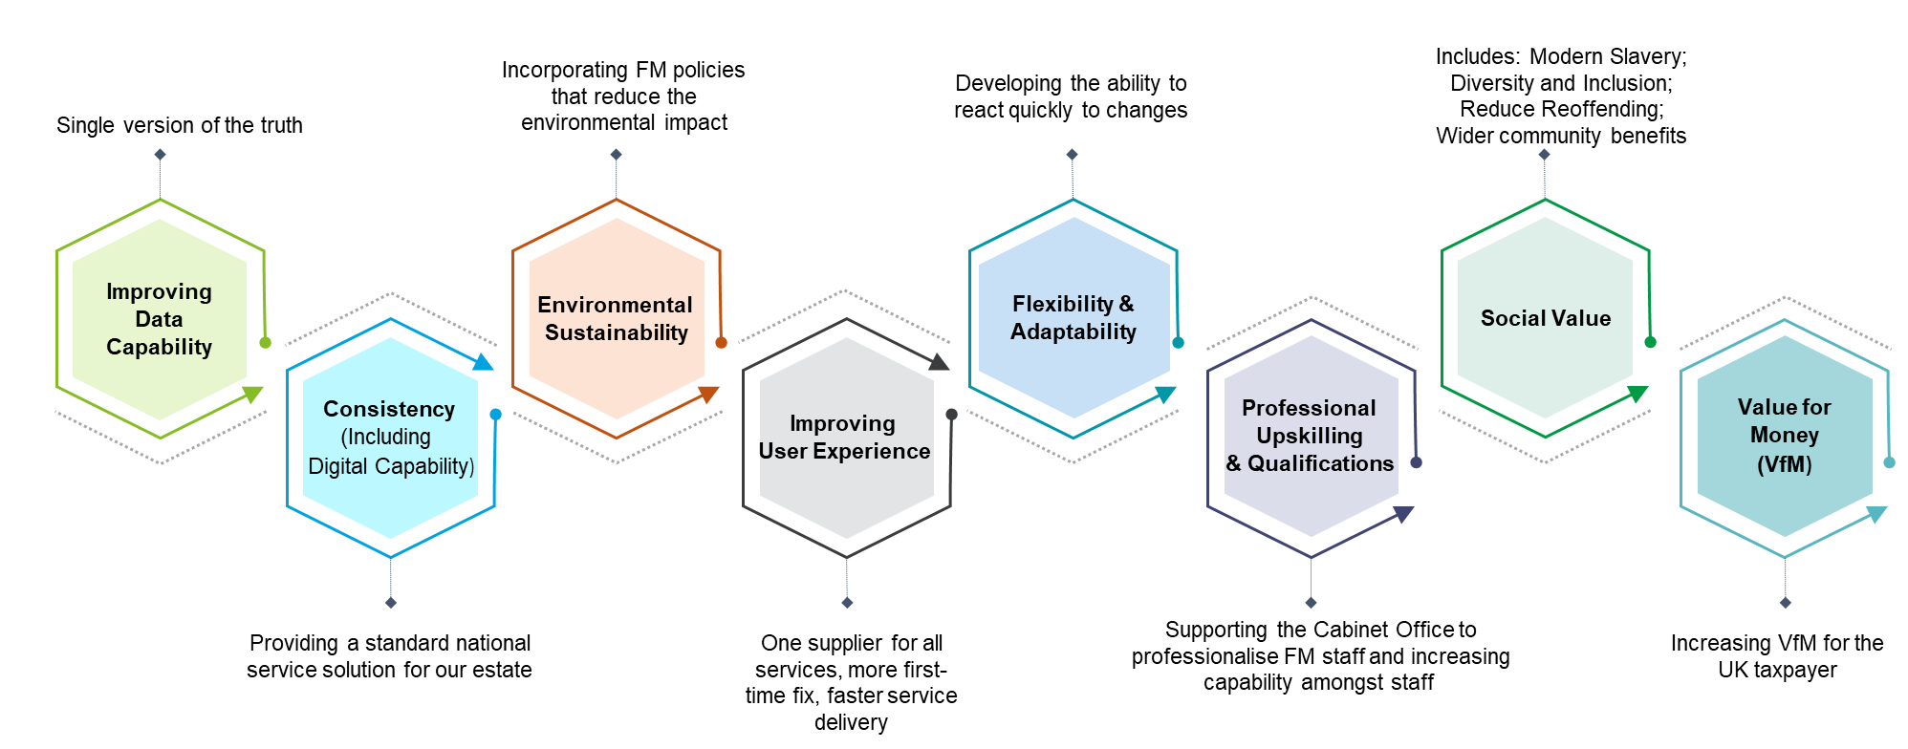
Property Transformation Programme
Introduction
One of the biggest and most ambitious procurement programmes across Government
Aims to deliver a tranche of Facilities Management contracts across HMPPS’ Prison and Probation Estate
A transformative programme, guided by multiple organisational and governmental strategies
The Golden Thread

Slide 6
Timing of Mobilisation & Demobilisation
We are mobilising 5 Total Facilities Management (TFM) contracts
We are mobilising one ‘Workplace Services Management (WSM) contract and demobilising 8 existing contracts over the next 2 years
2024
2025
2026
Q1 | Q2 | Q3 | Q4 | Q1 | Q2 | Q3 | Q4 | Q1 | Q2 | Q3 | Q4
WSM Mobilisation
Post WSM Mob
Internal Pre-Mobilisation
TFM Mob – Phase 1
Post TFM Mob
TFM Mob – Phase 2
TFM Mob – Phase 3
De - Mobilisation
Internal Pre-Mobilisation
Work with People & Comms Workstream
Comms prog with HMPPS
Buyers contract Management training (HOPOs etc)
FM Hand-book for Property
Prepare guides for HMPPS
Drop-in surgeries by phone for Q&A
Launch Internal Mobilisation Teams
Prep for ITT Evaluation
Internal Go-Live rehearsal.
Scenario planning sessions
Recruit demob/mob SMEs
Contract Demobilisation
Liaise with BAU teams
Pre-Award of new contracts
Prepare demob comms plan
Prepare checklists/meetings
Bring on board extra Management
Rehearse post award actions
Post Award:
Check BAU exit plans
Start data checklist/transfer
Quality control on data
Milestones/contract enacted
Demobilisation of the Integrator contract (8 contracts being demobilised in total)
Contract Mobilisation
Work with New Supplier
Launch HMPPS award coms
HMPPS Management Induction
Clarify checklists/milestones
Run training on processes
Helpdesk & CAFM monitoring
Pilots, trial runs, scenarios to inform Go/No Go decisions.
Trigger points for Go/No Go
Agree plan for Transition
Implement paymech / reporting
Launch ‘One Team’ charter
Post-mobilisation
Transition
Clarify checklists/milestones
Launch user feedback mechanism
Launch paymech / performance reporting
Adjust processes if necessary
Joint Buyer / winning bidder(s) ‘refresher training’
Problem solve the ‘parked items’
Alter comms/handbook/guides
Lessons Learned/Benefits
Key: All dates are based on financial quarters

Slide 7

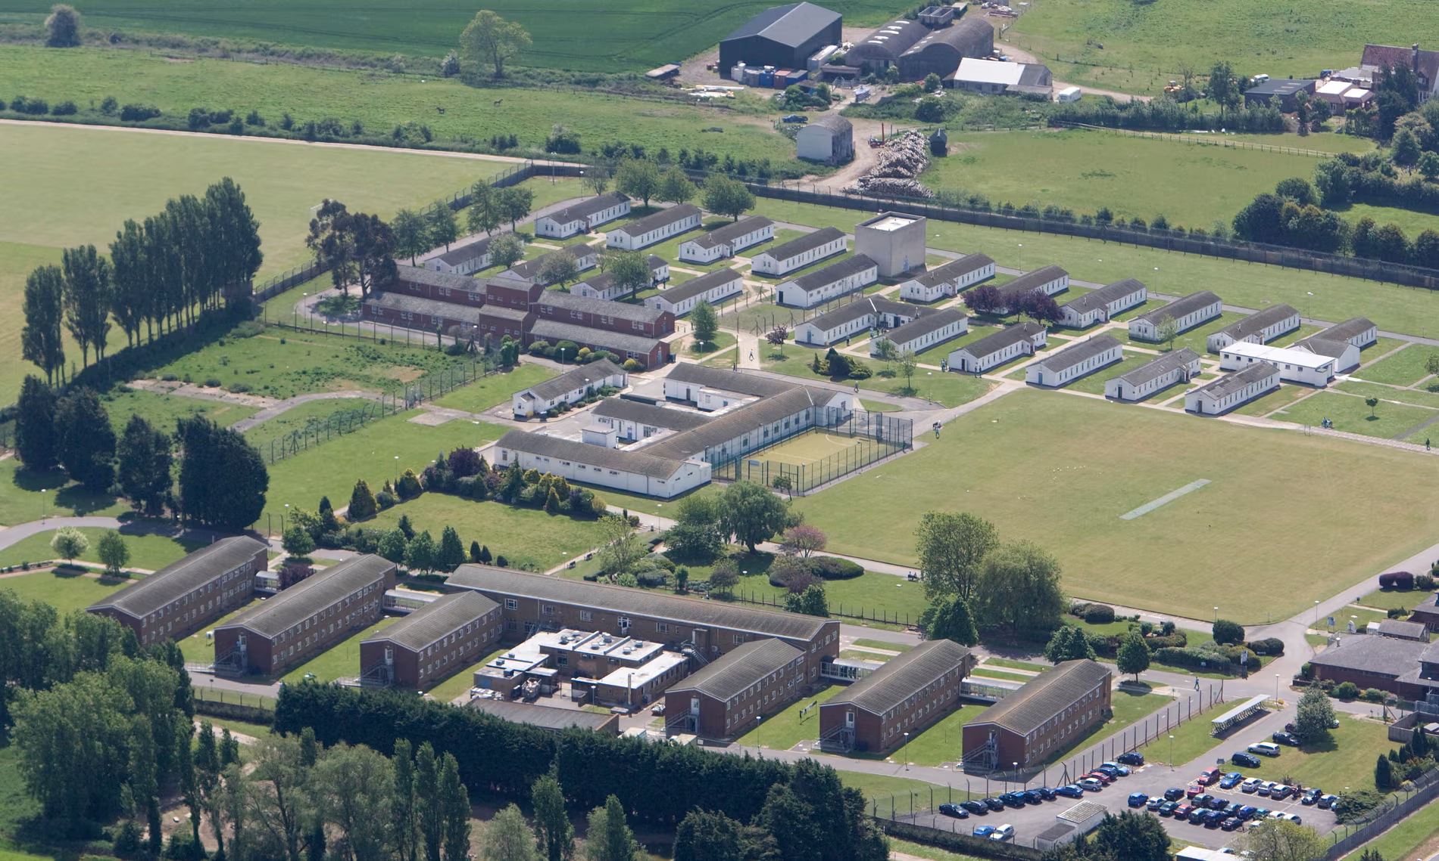
Overview
MoJ Property:
Provides specialist services including facilities management (maintenance, cleaning, waste, projects) health and safety, fire safety and security, technical design expertise, and sustainability to the prison & probation estate – our internal customer is HM Prisons & Probation Service.
Has business management teams who support the entire Directorate and each of our partners is supported by account management teams.
Is responsible for a great deal - our portfolio consists of properties valued at £9.3bn for the MoJ alone. We are part of the Government Property Profession (GPP) and through active membership and engagement we will work with the Office of Government Property to develop the maturity of the profession and also encourage our people to join the GPP.
Is committed to build our capability through training and recruitment, aspiring to be the best that we can be as individuals and as a directorate.
Is seeking to deliver new ways of working across our portfolio – leading on the scale and pace of activity for central government – proposing ways to achieve, and then providing more dynamic and flexible workspace, while driving down the cost of the estate.
Team Overview
The Mobilisation Team sits in the Property Transformation Programme, which is part of the MOJ Property Directorate.
The team is responsible for planning and delivering the mobilisation of new facilities management contracts, carefully aligning to the demobilisation of the current contracts.
The team will stand up the new contracts, working closely with the Digital Design team, FM Technical experts and BAU to implement the new Target Operating Model.
Our internal client, HMPPS, manages prisons and probation premises ranging from large sites with multiple buildings to small accommodation units

Slide 8
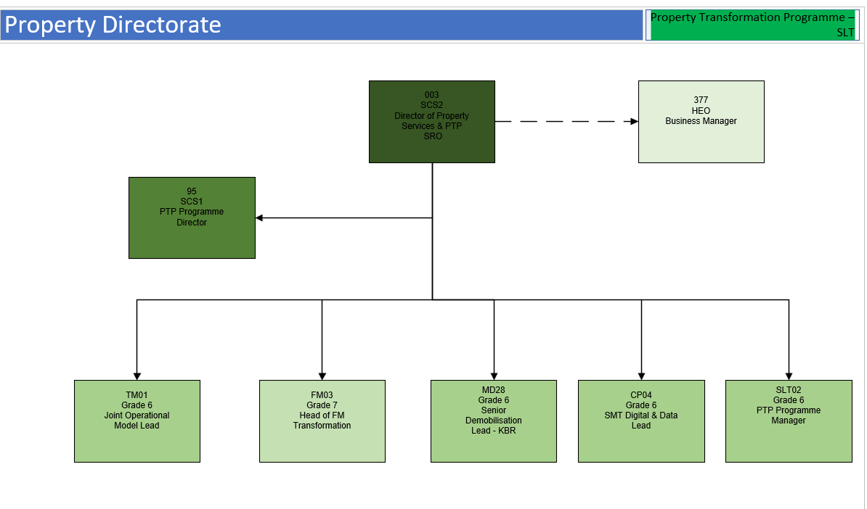
What the team looks like

